Slide 1
COBOL - 1
ITEB113

Slide 2
Lesson-2
Divisions of Cobol

Slide 3
IDENTIFICATION & ENVIRONMENT DIVISION
The IDENTIFICATION AND ENVIRONMENT DIVISION
Are the first two leading divisions of any COBOL program.
These divisions contain entries that are required to either identify the program or describe the computer system to be used for the compilation and execution of the program.
Generally, the entries in these divisions are used only for
documentation purposes.

Slide 4
Identification Division
The structure of Identification division is given below.
IDENTIFICATION DIVISION.
PROGRAM-ID. Entry.
AUTHOR. Entry.
INSTALLATION. Entry.
DATE-WRITTEN. Entry. Optional
DATA-COMPILED. Entry.
SECURITY. Entry.
REMARKS. Entry.

Slide 5
Environment Division
It is the most machine-dependent division.
The computer and all peripheral devices required by the program are described in this division.
This division contains two sections:
1.) CONFIGURATION SECTION
2.) INPUT-OUTPUT SECTION.
Of these the CONFIGURATION SECTION appears first.

Slide 6
Environment Division (continued)
The outline of the sections and paragraphs of this division is shown below.
ENVIRONMENT DIVISION.
CONFIGURATION SECTION.
SOURCE-COMPUTER. source-computer-entry.
OBJECT-COMPUTER. object-computer-entry.
SPECIAL NAMES. special-computer-entry.
INPUT-OUTPUT SECTION.
FILE CONTROL. {file-control-entry}….
I-O-CONTROL. input-output-control-entry.

Slide 7
Environment Division (continued)
For most compilers the COBOL source program must at least include the two section headings and the three paragraphs-SOURCE-COMPUTER, OBJECT-COMPUTER and FILE-CONTROL.
The division headings, section headings and the paragraph headings should be coded as Margin A entries. The paragraph headings must be followed by a period and then a space.
The entries in the paragraphs are Margin B entries and can start in the same line with the paragraph heading.

Slide 8
Environment Division (continued)
CONFIGURATION SECTION
This section contains an overall specification of the computer used for the purpose of compilation and execution of the program.
There are in all three paragraphs in this section, namely, source-computer, object-computer and special names.

Slide 9
Environment Division (continued)
SOURCE-COMPUTER
This paragraph specifies the name of the computer used to compile the COBOL program. The following is the form of this paragraph.
SOURCE-COMPUTER. computer-name.
For example, if ICL 1901 is to be used for compiling the COBOL source program, this paragraph should be as follows:
SOURCE-COMPUTER. ICL-1901

Slide 10
Environment Division (continued)
OBJECT-COMPUTER
The OBJECT-COMPUTER paragraph describes the computer on which the program is to be executed. The following shows the syntax for this paragraph.
OBJECT-COMPUTER. computer-name
[, MEMORY SIZE interger-1]
[, PROGRAM COLLATING SEQUENCE IS alphabet-name]
[, SEGMENT-LIMIT IS interger-2].

Slide 11
Environment Division (continued)
The computer name specifies a particular computer on which the object program is to be executed.
The MEMORY SIZE is used to indicate the amount of storage available to the object program. This clause is also used in conjunction with the SORT verb.
The PROGRAM COLLATING SEQUENCE clause specifies the collating sequence that is to be used to compare nonnumeric data items.
The alphabet name in this clause should be defined in the SPECIAL-NAMES paragraph to specify a collating sequence. If this clause is absent, the machine’s own collating sequence called NATIVE, is assumed.
The SEGMENT-LIMIT clause is used in most of the compilers to indicate that the sections having segment number less that the number specified in
integer-2 should be held in the permanent area of storage and should not be transferred to and from the virtual memory.
All the entries in this paragraph are terminated using period ( a dot).

Slide 12
Environment Division (continued)
The following is an example of the OBJECT-COMPUTER paragraph.
OBJECT-COMPUTER.
MEMORY SIZE 8000 WORDS.

Slide 13
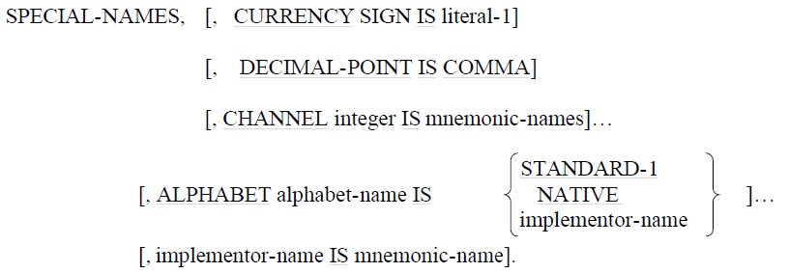
Environment Division (continued)
SPECIAL-NAMES
This paragraph is used to relate some hardware names to user-specified mnemonic names. This paragraph is optional in all compilers. The following is the format of this paragraph.

Slide 14
Environment Division (continued)
The CHANNEL clause is used to control the line spacing of line printers. This clause is used to associate a user-defined name called the mnemonic name with a channel in the printer carriage control. The range of integer depends on the particular line printer to be used. This mnemonic name can only be used in a WRITE statement.
The ALPHABET clause specifies a user-defined alphabet name that can be used to indicate a collating sequence in the PROGRAM COLLATING SEQUENCE clause discussed above or in the collating sequence clause in the sort verb. The word NATIVE stands for the computer’s own collating sequence and STANDARD-1 stands for the ASCII collating sequence. The alphabet name is also used to define the external character set in which the data is recorded on a file.

Slide 15
Environment Division (continued)
INPUT-OUTPUT SECTION
This section contains information regarding files to be used in the program. There are two paragraphs in this section:
1.) FILE-CONTROL
2.) I-O-CONTROL.
FILE-CONTROL is used almost in every program. In the following some of the entries of the FILE-CONTROL paragraph will be discussed.
The INPUT-OUTPUT SECTION is optional in many computers.

Slide 16
Environment Division (continued)
FILE-CONTROL
The FILE-CONTROL paragraph names each file and identifies the first medium through file control entries. The simplified format of a file control entry is given below.
SELECT [OPTIONAL] file-name ASSIGN TO hardware/file name.
An example of the FILE-CONTROL paragraph is given below.
FILE-CONTROL.
SELECT INPUT-FILE ASSIGN TO “IN.DAT”.
SELECT PRINTER-FILE ASSIGN TO PRINTER.

Slide 17
DATA DIVISION
The DATA DIVISION is that part of a COBOL program where every data item processed by the program is described.
It is important to note that unless a data item is described in the DATA DIVISION, it cannot be used in the procedure division.
The DATA DIVISION is divided into a number of sections such as File Section, Working-storage section, Linkage section, Communication section , Report Section, and Screen section.
Depending on the use of a data item, it should be defined in the appropriate section.

Slide 18
DATA DIVISION (continued)
FILE SECTION
The FILE SECTION includes the description of all data items that should be read from or written onto some external file.
b) WORKING-STORAGE SECTION
The data items which are developed internally as intermediate result as well as the constants are described in this section of the DATA DIVISION.
c) COMMUNICATIONS SECTION
Used by another optional module, the Communications
Facility.
d) LINKAGE SECTION
Passes data between programs.

Slide 19
DATA DIVISION (continued)
e) REPORT SECTION
Used by another optional module, the Report Writer.
f) SCREEN SECTION
Describes a screen full of input, output, and update data for the user interface.

Slide 20
DATA DIVISION (continued)
Sample format of the DATA DIVISION is as follows:
DATA DIVISION.
FILE SECTION.
FD Input-File.
01 Input-Record Pic X(100).
WORKING-STORAGE SECTION.
01 Work-Field Pic X(20).

Slide 21
DATA DIVISION (continued)
All the section names as well as the division name must be coded as margin A entries.
Each section of the DATA DIVISION is optional which means that a section may be omitted if there is no data that may be described in a particular section.
It is important to note that the sections to be included must appear in the order shown above.

